Slide 1
Chapter 4
Data Models

Slide 2
In this chapter, you will learn:
Why data models are important
About the basic data-modeling building blocks
What business rules are and how they affect database design
How the major data models evolved, and their advantages and disadvantages
How data models can be classified by level of abstraction

Slide 3
Data Modeling
Data modeling is a method for determining what data and relationships should be stored in the database.
The goal is to identify the facts that must be stored in the database.
The goal is to create a data model that is an accurate representation of data needs and real-world data relationships.

Slide 4
Data Models
Data models are a collection of conceptual tools for describing data, data relationships, data semantics and data constraints. The two major conceptual models in use today are:
Entity-Relationship Model (ERD)
Class Diagram (Object-oriented).

Slide 5
The Importance of Data Models
Data model
Relatively simple representation, usually graphical, of complex real-world data structures
Communications tool to facilitate interaction among the designer, the applications programmer, and the end user
Good database design uses an appropriate data model as its foundation
End-users have different views and needs for data
Data model organizes data for various users

Slide 6
Business Rules (in an organisation)
Brief, precise, and unambiguous description of a policy, procedure, or principle within a specific organization’s environment
Apply to any organization that stores and uses data to generate information
Description of operations that help to create and enforce actions within that organization’s environment

Slide 7
Business Rules and Data Modeling
Business rules are important in data modeling because they govern how data are handles and stored
To understand the nature of the business in order to determine how best to model the database
What does the organization do to operate?
What limits are placed on how the business performs daily tasks?
How does the business make its money?
Essentially, business rules cover:
Any types of organizational policies of any form and at all levels of the organization.
Any types of calculations or formulas (such as loan amortization calculations for a mortgage lending company).
Any types of rules and regulations (such as rules applied because of legal requirements, self-imposed restrictions, or industry-standard requirements).

Slide 8
Examples of Business Rules
A customer may make many payments on account. Each payment on account is credited to only one customer.
A machine operator may not work more than 10 hours in any 24-hour period.
A business trip destination must be at least 100 miles away for an airline ticket to be purchased.
A training cannot be scheduled for fewer than 10 employees or for more than 30 employees.
A lab cannot be scheduled for demonstration purposes for more than one-hour per day.
A customer may receive many invoices. Each invoice is received by only one customer.

Slide 9
Importance of Business Rules
Promote creation of an accurate data model
Standardize company’s view of data
Constitute a communications tool between users and designers
Allow designer to understand the nature, role, and scope of data
Allow designer to understand business processes
Allow designer to develop appropriate relationship participation rules and constraints

Slide 10
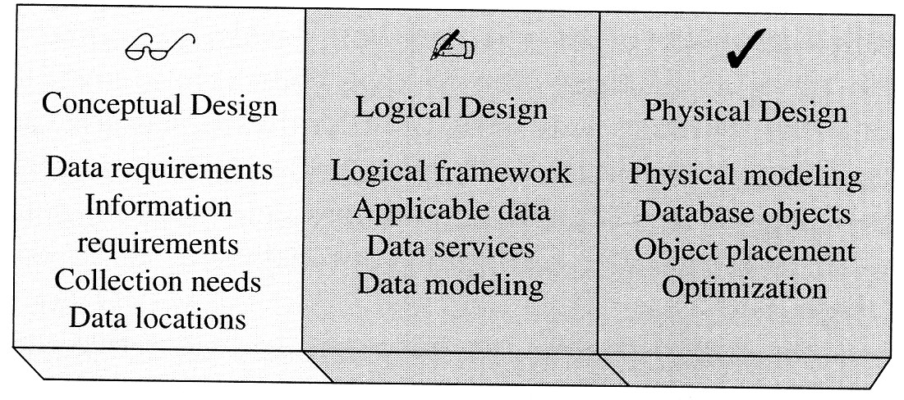
Data Models
Used in various stages of database design

Slide 11
Conceptual data model
A conceptual data model identifies the highest-level relationships between the different entities. Features of conceptual data model include:
Includes the important entities and the relationships among them.
No attribute is specified.
No primary key is specified.
Two common tools to produce conceptual model are:
Entity-relationship model (ERD)
Object-oriented data model e.g. UML
Specific modeling grammars
Every method has its own set of (graphical) constructs and the rules that show how to combine the constructs for modeling real-world domains

Slide 12
Advantages of Conceptual Model
Provides a relatively easily understood macro level view of data environment
Independent of both software and hardware
Does not depend on the DBMS software used to implement the model
Does not depend on the hardware used in the implementation of the model
Changes in either the hardware or the DBMS software have no effect on the database design at the conceptual level

Slide 13
Specific modelling grammars for the the E-R Model
The entity-relationship model is based on a perception of the world as consisting of a collection of basic objects (entities) and relationships among these objects.
An entity is a distinguishable object that exists.
Each entity has associated with it a set of attributes describing it.
E.g. number and balance for an account entity.
A relationship is an association among several entities.
e.g. A cust_acct relationship associates a customer with each account he or she has.
The set of all entities or relationships of the same type is called the entity set or relationship set.
Another essential element of the E-R diagram is the mapping cardinalities, which express the number of entities to which another entity can be associated via a relationship set.

Slide 14
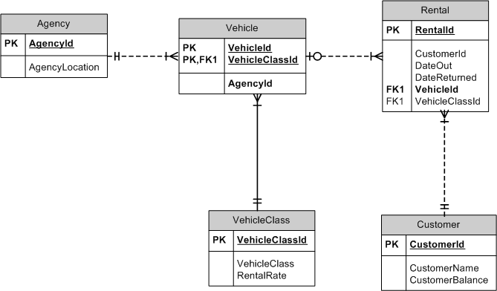
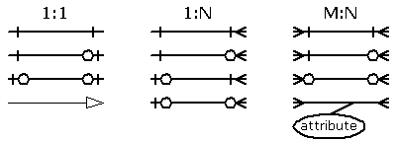
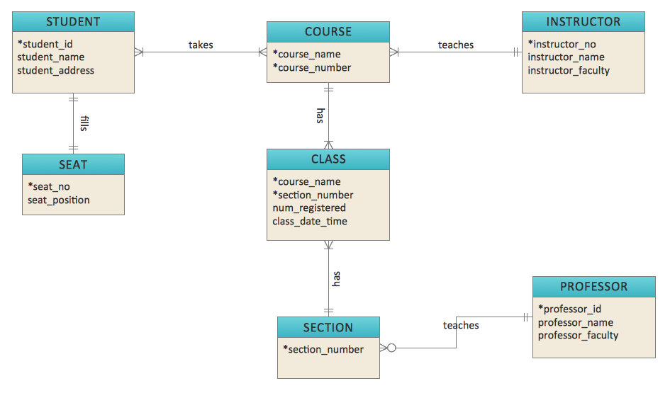
The E-R Model

Slide 15
The Entity Relationship Model
Advantages
Exceptional conceptual simplicity
Visual representation
Effective communication tool
Integrated with the relational data model

Slide 16
The Entity Relationship Model (continued)
Disadvantages
Limited constraint representation
Limited relationship representation
No data manipulation language
Loss of information content

Slide 17
The Object Oriented Model
Semantic data model (SDM) developed by Hammer and McLeod in 1981
Modeled both data and their relationships in a single structure known as an object
OODM becomes the basis for the object oriented database management system (OODBMS)

Slide 18
The Object-Oriented Model
Why OO?
Conventional data models (e.g., relational) are inadequate
Can’t model complex and unstructured data
Can’t model processes (dynamic behavior)
Doesn’t support reuse
A more ‘natural’ way to represent the real world
Encapsulation – incorporating both data and functions in a unit where they are protected from modification from outside

Slide 19
Specific modelling grammars for the The Object-Oriented Model
The Object-Oriented Model
The object-oriented model is based on a collection of objects, like the E-R model.
An object contains values stored in instance variables within the object.
Unlike the record-oriented models, these values are themselves objects.
Thus objects contain objects to an arbitrarily deep level of nesting.
An object also contains bodies of code that operate on the the object.
These bodies of code are called methods.
Objects that contain the same types of values and the same methods are grouped into classes.
A class may be viewed as a type definition for objects.
Analogy: the programming language concept of an abstract data type.
The only way in which one object can access the data of another object is by invoking the method of that other object.
This is called sending a message to the object.
Internal parts of the object, the instance variables and method code, are not visible externally.
Result is two levels of data abstraction.

Slide 20
Specific modelling grammars for the The Object-Oriented Model
The Object-Oriented Model
For example, consider an object representing a bank account.
The object contains instance variables number and balance.
The object contains a method pay-interest which adds interest to the balance.
Under most data models, changing the interest rate entails changing code in application programs.
In the object-oriented model, this only entails a change within the pay-interest method.
Unlike entities in the E-R model, each object has its own unique identity, independent of the values it contains:
Two objects containing the same values are distinct.
Distinction is created and maintained in physical level by assigning distinct object identifiers.

Slide 21
Object Oriented Data Model— Basic Structure
Object: abstraction of a real-world entity
Attributes describe the properties of an object
Objects that share similar characteristics are grouped in classes
Classes are organized in a class hierarchy
Inheritance is the ability of an object within the class hierarchy to inherit the attributes and methods of classes above it

Slide 22
The Object Oriented Model
Advantages
Adds semantic content
Visual presentation includes semantic content
Database integrity
Both structural and data independence

Slide 23
The Object Oriented Model (continued)
Disadvantages
Slow pace of OODM standards development
Complex navigational data access
Steep learning curve
High system overhead slows transactions
Lack of market penetration

Slide 24
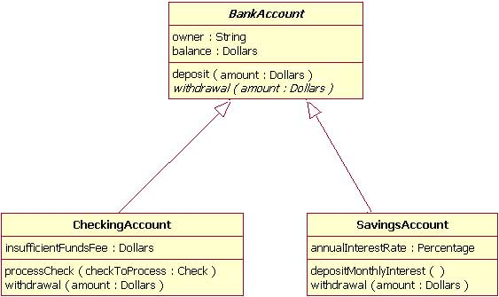
Class diagram in UML

Slide 25
The Evolution of Data Models
Logical data model
Hierarchical data model
Network data model
Relational data model
Entity relationship
This tool is versatile enough to be used for both conceptual and logical modeling
Object oriented

Slide 26
The Hierarchical Model—Evolution
GUAM (Generalized Update Access Method)
Based on the recognition that the many smaller parts would come together as components of still larger components
An example is Information Management System (IMS) created by IBM
World’s leading mainframe hierarchical database system in the 1970s and early 1980s

Slide 27
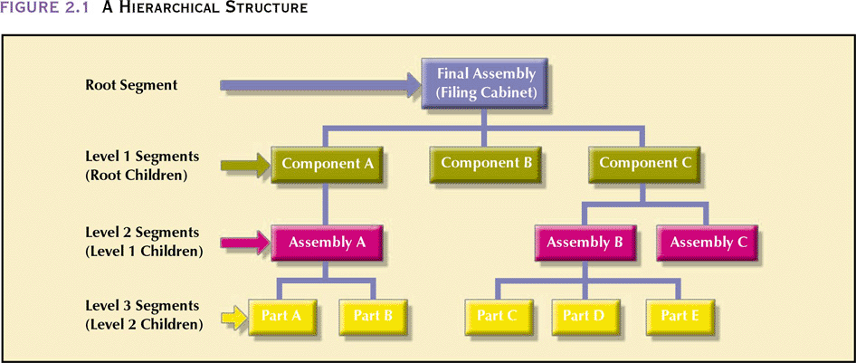
A Hierarchical Structure

Slide 28
Hierarchical Structure—Characteristics
Each parent can have many children
Each child has only one parent
Tree is defined by path that traces parent segments to child segments, beginning from the left
Hierarchical path
Ordered sequencing of segments tracing hierarchical structure
Preorder traversal or hierarchic sequence
“Left-list” path

Slide 29
The Hierarchical Model—Characteristics
Basic concepts form the basis for subsequent database development
Limitations lead to a different way of looking at database design
Basic concepts show up in current data models
Best used in manufacturing process environment
One big component made up of other sub-component
Each sub-component made up of smaller components, etc.
Is also referred as “Bill-of-material” (BOM)

Slide 30
A Hierarchical Structure
CAR
Engine
Steering
Suspension
Engine Block
Spring
Absorber

Slide 31
The Hierarchical Model
Advantages
Conceptual simplicity
Database security
Data independence
Database integrity
Efficiency

Slide 32
The Hierarchical Model (continued)
Disadvantages
Complex implementation
Difficult to manage
Lacks structural independence
Complex applications programming and use
Implementation limitations
Lack of standards

Slide 33
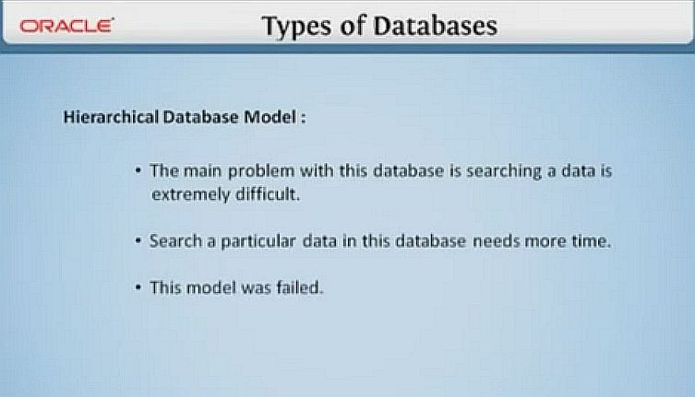
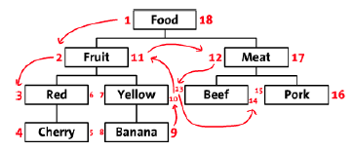
The Hierarchical Model (continued)
Preorder traversal or hierarchic sequence “Left-list” path takes 18 steps to find “Pork” and return its value

Slide 34
The Network Model
Created to
Represent complex data relationships more effectively
Improve database performance
Impose a database standard
Standard defined by Conference on Data Systems Languages (CODASYL) of the American National Standards Institute (ANSI) Database Task Group (DBTG)
Also known as the CODASYL-DBTG model

Slide 35
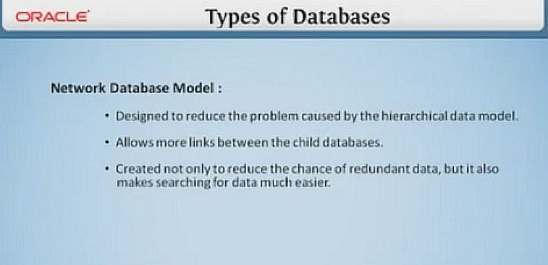
The Network Model

Slide 36
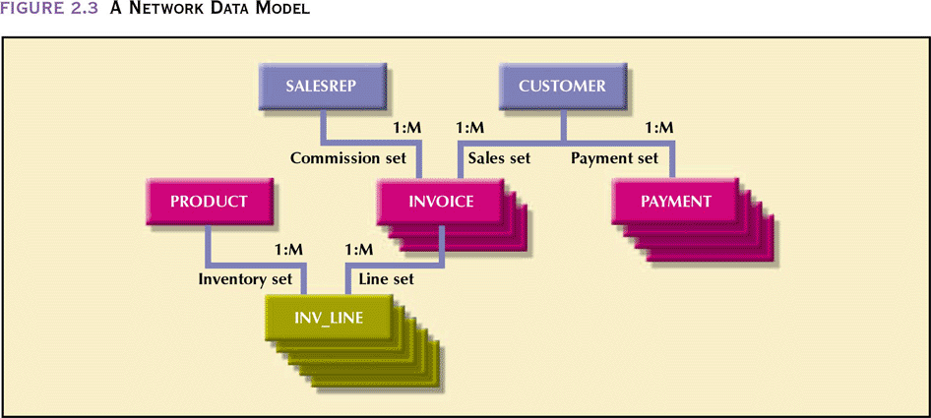
A Network Data Model

Slide 37
The Network Data Model
Advantages
Conceptual simplicity
Handles more relationship types
Data access flexibility
Promotes database integrity
Data independence
Conformance to standards

Slide 38
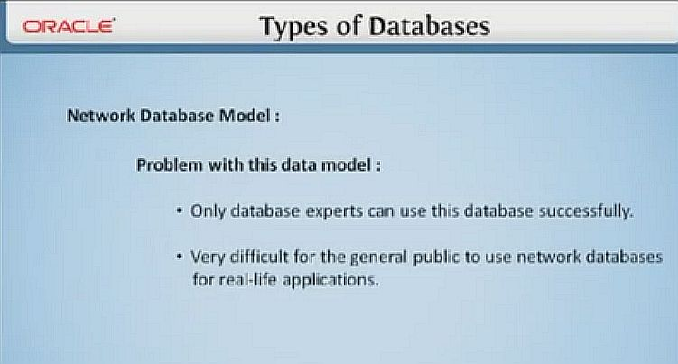
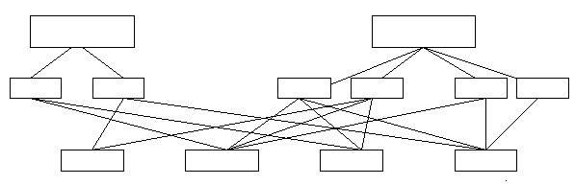
The Network Model

Slide 39
The Network Data Model (continued)
Disadvantages
System complexity
Lack of structural independence

Slide 40
The Relational Model
Developed by Codd (IBM) in 1970
Considered ingenious but impractical in 1970
Conceptually simple
Computers lacked power to implement the relational model when it was first proposed
Today, PCs can run sophisticated relational database software (e.g. Oracle Express on your PC)

Slide 41
The Relational Model—Basic Structure
Relational Database Management System (RDBMS)
Performs same basic functions provided by hierarchical and network DBMS systems, plus other functions
Most important advantage of the RDBMS is its ability to let the user/designer operate in a human logical environment

Slide 42
The Relational Model— Basic Structure (continued)
Table (relations)
Matrix consisting of a series of row/column intersections
Related to each other by sharing a common entity characteristic
Relational schema
Visual representation of relational database’s entities, attributes within those entities, and relationships between those entities

Slide 43
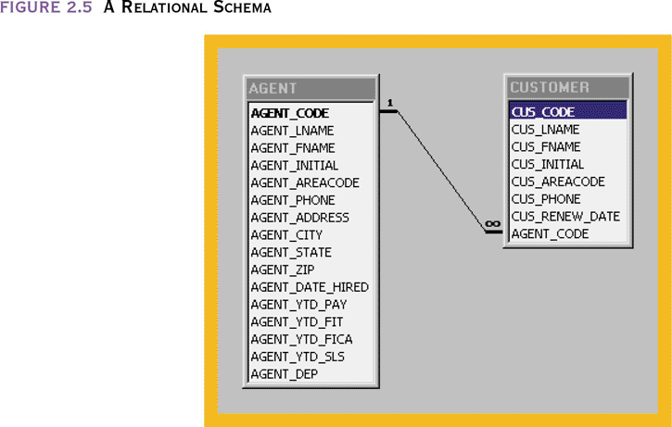
A Relational Schema
43

Slide 44
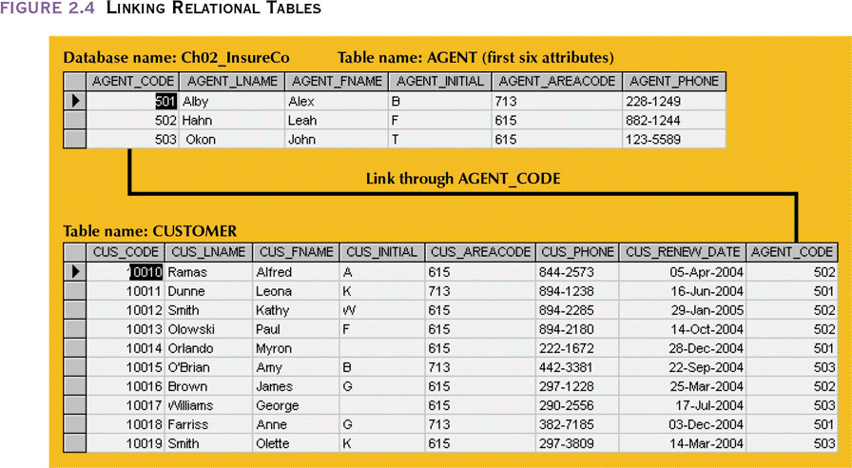
Linking Relational Tables
44

Slide 45
Relational Table
Stores a collection of related entities
Resembles a file
Relational table is purely logical structure
How data are physically stored in the database is of no concern to the user or the designer
This property became the source of a real database revolution

Slide 46
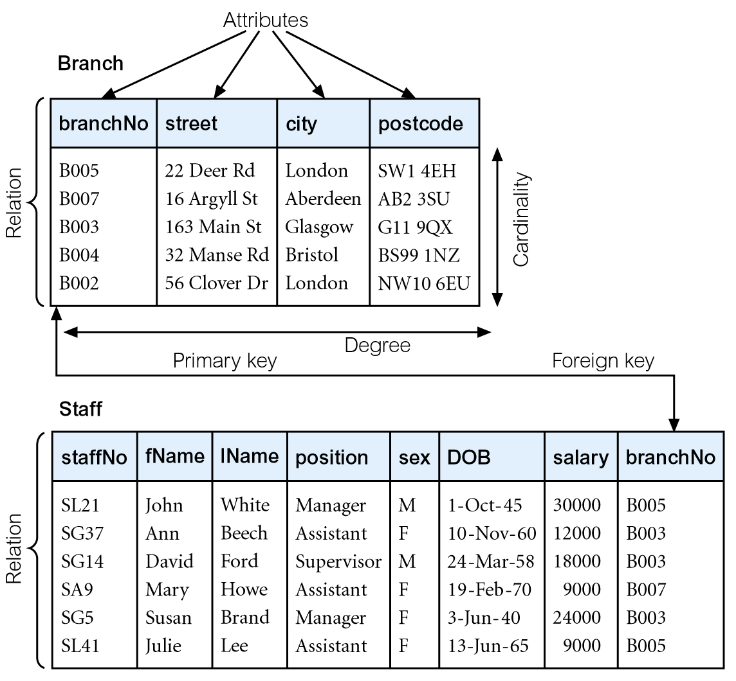
The Relational Model
Data and relationships are represented by a collection of tables.
Each table has a number of columns with unique names, e.g. customer, account.

Slide 47
The Relational Model
Advantages
Structural independence
Improved conceptual simplicity
Easier database design, implementation, management, and use
Ad hoc query capability through the use of SQL
Powerful database management system

Slide 48
The Relational Model (continued)
Disadvantages
Substantial hardware and system software overhead
Can facilitate poor design and implementation
May promote “islands of information” problems

Slide 49
Entity Relationship Diagram (ERD) modeling tool

Slide 50
The Entity Relationship Model
Widely accepted and adapted graphical tool for data modeling
Introduced by Chen in 1976
Graphical representation of entities and their relationships in a database structure
A top-down approach to data modeling

Slide 51
Building Blocks of Data Model
Customer
Region
Supplier
Entities
Order
Product
Despatch Note
Relationships

Slide 52
Entity
Meaning. A class of persons, places, objects, events, or concepts about which we need to capture and store data (crudely, it is a file and described using a noun).
Examples : customers, products, suppliers, employees, departments
Using singular or plural nouns is a matter of preference
Notation - it is represented by a rectangle.
ORDER

Slide 53
What Should an Entity Be?
SHOULD BE:
An object that will have many instances in the database
An object that will be composed of multiple attributes
An object that we are trying to model
SHOULD NOT BE:
A user of the database system
An output of the database system (e.g. a report)

Slide 54
Examples of Entities
Persons : agency, contractor, customer, department, division, employee, instructor, student, supplier
Places : sales region, building, room, branch office, campus
Objects : book, machine, part, product, raw material, software license, software package, tool, vehicle model, vehicle
Events : application, award, cancellation, class, flight, invoice, order, registration, renewal, requisition, reservation, sale, trip
Concepts : account, block of time, bond, course, fund, qualification, stock

Slide 55
Exercise for Students
List 4 appropriate entities for each of the following systems :
Inventory System
Human Resource System
Purchasing System
For each of the entities, list 4 attributes

Slide 56
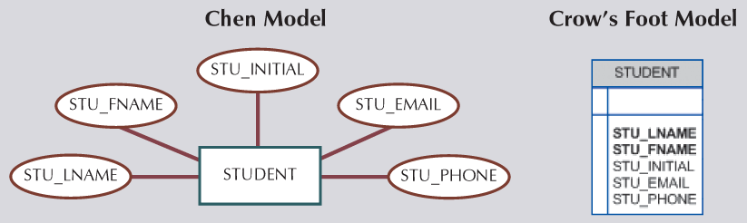
Attributes
Meaning - is a characteristic, data field, or data element of an entity. There are many attributes for each entity.
Example – Customer’s attributes are : Name, address, telephone, email
Notation :
DBDL or Textual notation
STUDENT (STU_ID, STU_LNAME, STU_FNAME, STU_INITIAL, STU_EMAIL, STU_PHONE)

Slide 57
Relationship
Meaning. The lines between the entities (boxes) representing relationships between them
Example. Between CUSTOMER and ORDER
Notation. The relationship is indicated by lines connecting the entities. There’s a “crow’s” foot or a diamond shaped box
Description : A relationship is read in two directions (left and right). Example : Each customer places many orders, and each order is placed by only one customer.
Customer
makes
Order
Customer
Order

Slide 58
Types of Relationships

Slide 59
Example - Types of Relationships
ONE-TO-ONE:
STUDENT
ID
CLASS
ONE-TO-MANY:
STUDENT
A
STUDENT
B
STUDENT
C
CLASS
1
CLASS
2
MANY-TO-MANY:
STUDENT
A
STUDENT
B
STUDENT
C

Slide 60
Types of Relationship
One-to-One (1 : 1)
One-to-Many (1 : N)
Invoice
Order
Driver
Truck
Customer
Order
Dept
Employee

Slide 61
Example of One-to-Many Relationship (in Access)
Example: A teacher can teach many students, and each student have one class teacher.

Slide 62
Many-to-Many Relationship
Meaning - When an entry can occur more than once on both sides of the relationship.
Examples
Each student can take many classes, and each class can contain many students
Each order contains many products, and each product can be listed in many orders.
Student
Class
Order
Product

Slide 63
Exercise for Students
Identify the entities, attributes and relationships in the following diagram.
CustomerID (PK)
CustomerName
CustomerAddress
CustomerTelephone
ReceiptNo (PK)
CustomerID (FK)
SalesDate
ProductCode (FK)
ProductCode (PK)
ProductDescription
SupplierID (FK)
QuantityInHand
Selling Price
Customer
Sale
Product
SupplierID (PK)
SupplierName
SupplierAddress
SupplierTelephone
Supplier

Slide 64
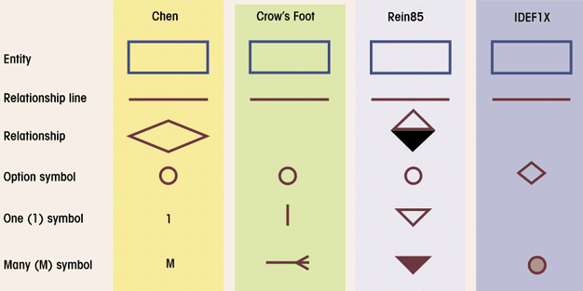
ERD Notation
We only use this for examination and assignment submission

Slide 65
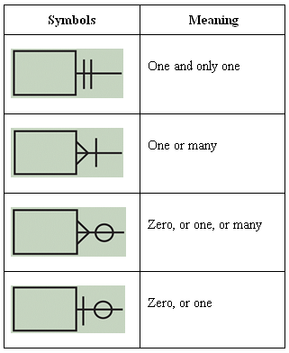
IMPORTANT
Cardinality
Expresses minimum and maximum number of entity occurrences associated with one occurrence of related entity
Established by very concise statements known as business rules
Important Note:
These are the only symbols to be used in tests and exam questions
From this slide onwards, these correct Crow’s foot notation should be used
Crow’s Foot Notation

Slide 66
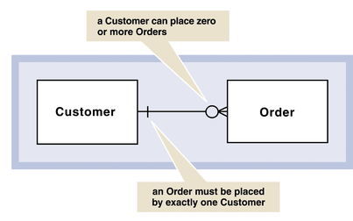
Crow’s Foot Notation
IMPORTANT
Describes the cardinality of relationship between two entities
Shows how instances of one entity relate to instances of another entity.
Because all relationships are bidirectional, cardinality must be defined in both directions for every relationship.

Slide 67
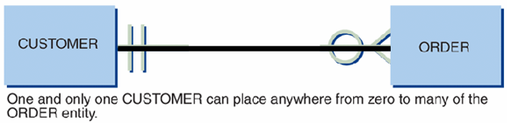
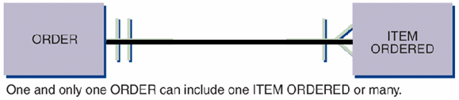
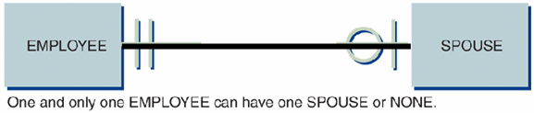
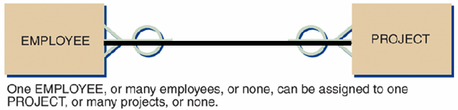
Crow’s Foot Notation
IMPORTANT
Ex:
Rewrite the relationships in both directions

Slide 68
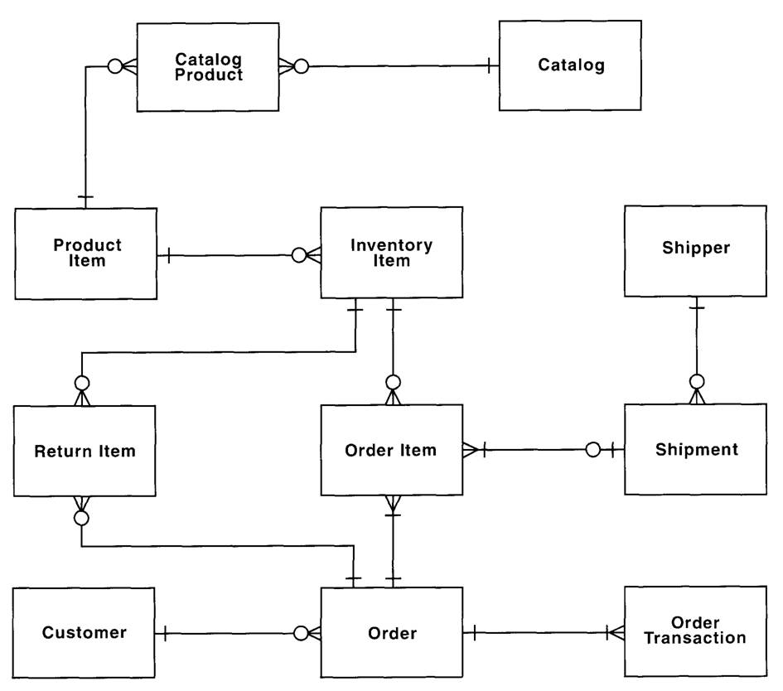
Example 1 of ERD
IMPORTANT

Slide 69
Example 2 of ERD
IMPORTANT
Customer
Region
Supplier
Entities
Order
Product
Despatch Note
Relationships

Slide 70
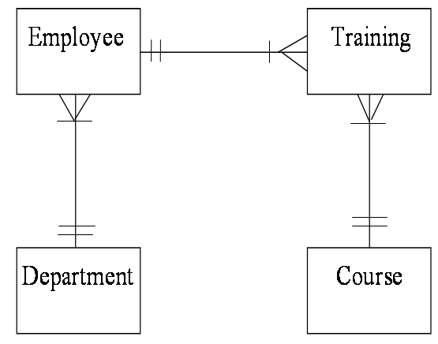
Example 3 of ERD
IMPORTANT

Slide 71
Example 4 of ERD
IMPORTANT
Supplier
Product
Customer
Purchase
Stock
Sales
Order
Order
Purchase
Sales
Items
Items

Slide 72
Resolving Many-to-Many Relationship

Slide 73
Associative Entities
Also known as weak entities
Used to implement M:N relationships
Composed of primary keys of each of the entities to be connected
By introducing an ‘associative’ entity to form a new 2 pairs of one-to-many relationships.

Slide 74

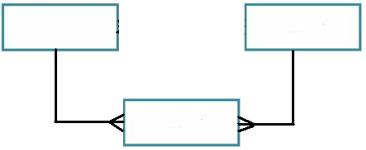
Example 1 – Associative Entity
By introducing an ‘associative’ entity to form a new 2 pairs of one-to-many relationships.
Before
Customer
Product
After
Customer
Product
Order
Associative Entity

Slide 75
Example - Attributes
Customer
Product
Order
CUSTOMER
ORDER
PRODUCT
CustomerID (PK)
LastName
FirstName
Address
PostCode
City
Phone
CustomerID
ProductID
PurchaseDate
Amount
ProductID (PK)
Name
UnitPrice
Identify the keys in ORDER entity

Slide 76
Example 2 - Resolving M:N Relationship
IMPORTANT
Advisor
Student
Advisor
Student
Course
Course
Grade
Associative entity

Slide 77
Example 3 – Resolving M:N Relationship
IMPORTANT
Member
Video
Member
Video
Rental
Associative entity

Slide 78
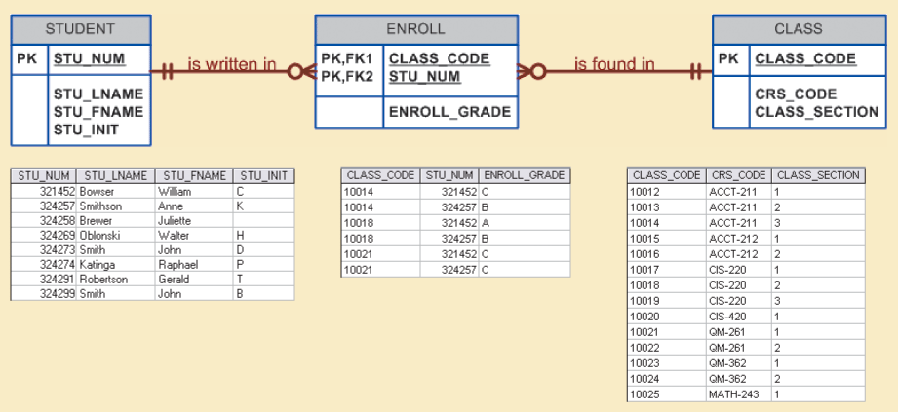
Example 4 – Resolving M:N Relationship

Slide 79
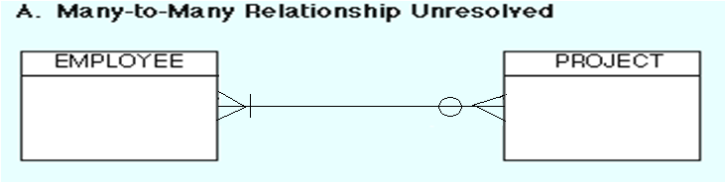
Exercise for Students
We normally do NOT implement M:N relationships in a relational database environment because they create many redundancies.
They must be split into 2 pairs of 1:M relationships by creating an associative entity.
Question - Each employee can be assigned to many projects, and each project can be done by by many employees (below).
Resolve the many-to-many relationship
List some attributes for each entity
EMPLOYEE
PROJECT

Slide 80
Exercise for Students
Task: Describe the relationship between the painter and the painting

Slide 81
Exercise for Students
Resolve the following many-to-many relationship

Slide 82
Relationship Degree
Indicates number of entities or participants associated with a relationship
Unary relationship
Association is maintained within single entity
Binary relationship
Two entities are associated
Ternary relationship
Three entities are associated

Slide 83
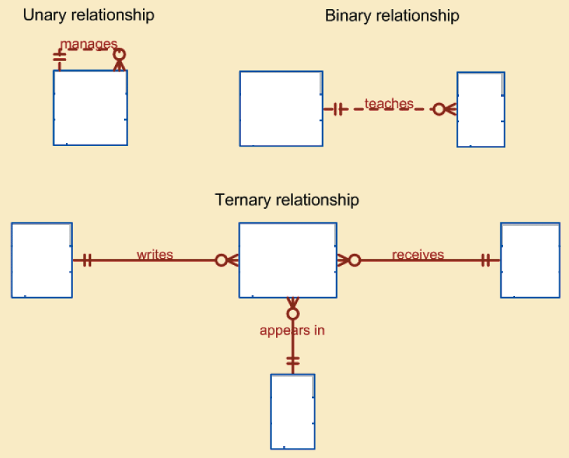
Relationship Degree
Employee
Professor
Class
Doctor
Prescription
Patient
Drug

Slide 84
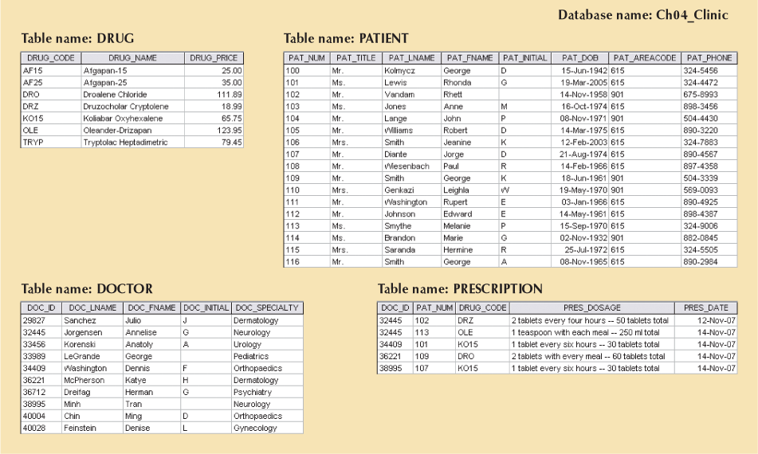
Example of Ternary Relationship

Slide 85
Data Dictionary
A data dictionary is a working tool for designers, programmers and power users who must deal directly with the database.
A simple data dictionary is an alphabetic list of tables and columns and their descriptions, and some technical details like data types and default values.
Programmers use it to look stuff up, to answer questions about the data. End users do the same thing when they're trying to construct ad-hoc reports.

Slide 86
Data Dictionary
Explanation of a term or fact
Term – word or phrase with specific meaning
Fact – association between two or more terms
Guidelines for good data definition
Gathered in conjunction with systems requirements
Accompanied by diagrams
Iteratively created and refined
Achieved by consensus

Slide 87
Why are Data Dictionaries Important?
a) In order to manage the details in large-scale systems.
Most systems are ongoing and dynamic and management of all the descriptive details is difficult, therefore an accurate and consistent recording technique is essential.
b) To communicate a common meaning for all of the elements in the system.
Simply making sure that for all elements, the meaning will remain consistent.
c) To document features of the system.
It is essential to document the circumstances under which data items occur. For example, what is the frequency of this process? Who has access to this datastore? Documenting these features will produce a more complete and better understanding of the system for the analyst.
d) To locate errors and omissions in the system.
The data dictionary may reveal information that is incomplete and/or inaccurate. It may show stores that are never accessed and/or processes that should be sub-divided, etc.

Slide 88
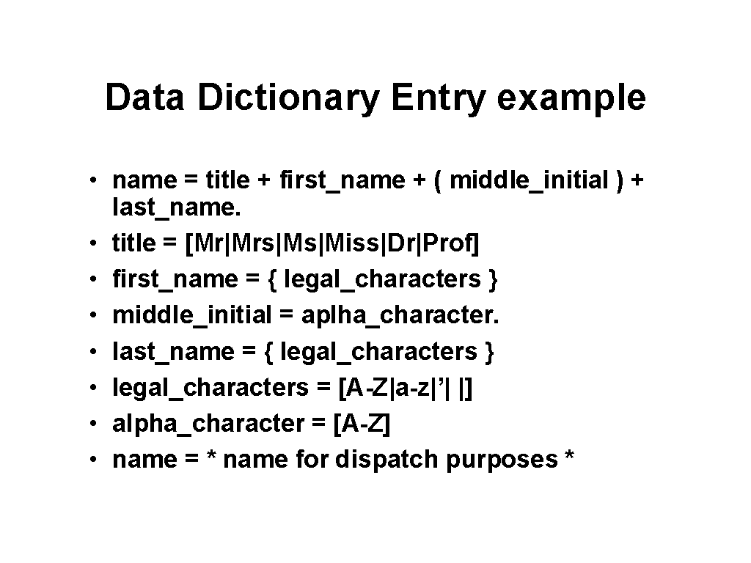
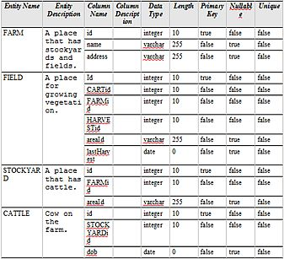
Data Dictionary examples

Slide 89
Exercise for Students
Customer
Invoice
Invoice Line
Product
Describe the above relationships and correct the errors in the use of crows’ foot symbols

Slide 90
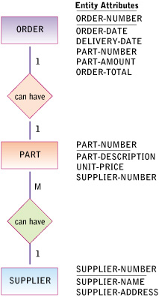
Example of ERD
EXERCISE: Redraw this ERD using Crow’s Foot notations.
Identify the various keys

Slide 91
Summary
A good DBMS will perform poorly with a poorly designed database
A data model is a (relatively) simple abstraction of a complex real-world data-gathering environment
Basic data modeling components are:
Entities
Attributes
Relationships

Slide 92
Summary (continued)
Relational model:
Current database implementation standard
Much simpler than hierarchical or network design
Object is basic modeling structure of object oriented model
Data modeling requirements are a function of different data views (global vs. local) and level of data abstraction

